Slide 2
Today:
Project Overview.
Content of PD this year: Academic Discussion strategies
Working with your Teacher Leader and Cohort.
Next steps.
Notes:
Laura

Slide 3
A little background…
The Bill & Melinda Gates Foundation
Center for the Future of Teaching & Learning at WestEd
Sixteen national organizations invited to apply. Six were funded.
CRF National Writing Project Teach Plus Readworks
National Board of Teaching Standards Teaching Matters

Slide 4
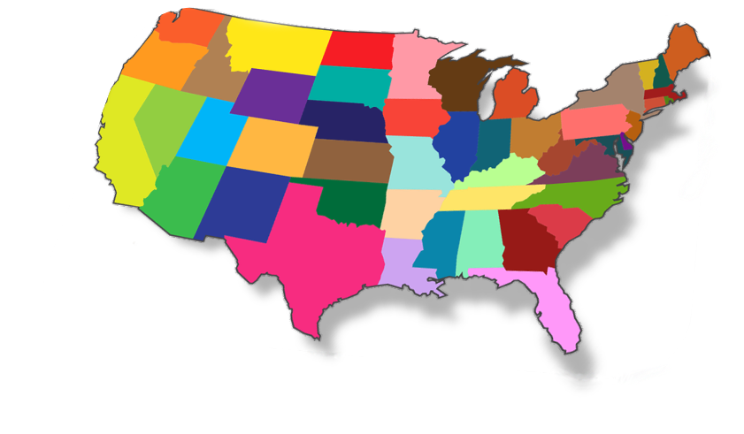
Carolina K-12
(Our other fabulous partner.)
Constitutional Rights Foundation
(That’s us.)
Florida Joint Center for Citizenship
(Our fabulous partner.)

Slide 5
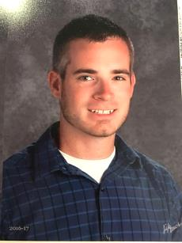
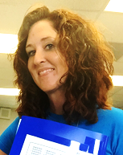
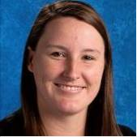
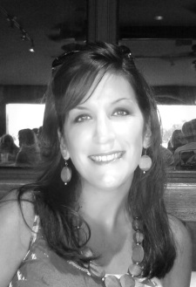
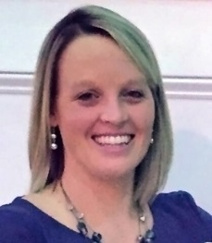
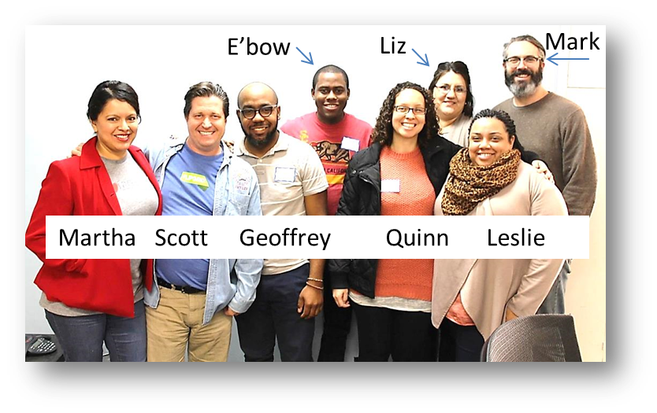
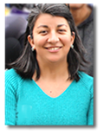
Meet your TL’s!
Florida: Osceola County
North Carolina: Guilford County:
Alissa
Joe
Lindsay
Jamie
Laura
North Carolina: Iredell Statesville County
Coming soon!
California: Los Angeles County
Jerry
Patricia

Slide 6
Project Activities
With your TL’s
Two F2F Sessions
Two Webinars
Asynchronous Online Discussions
What you get:
Opportunities to collaborate with other teachers
A certificate of completion.
Letter of commendation to your administrators.
Free curriculum materials.
Meals and snacks at face-to-face sessions.
A stipend!

Slide 7
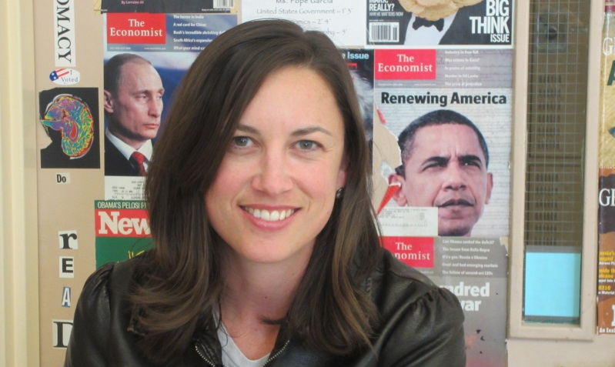
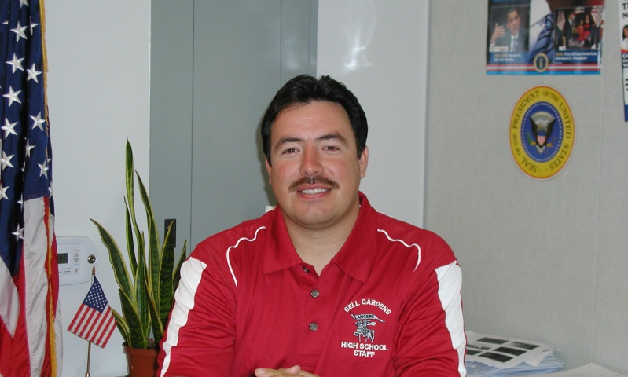
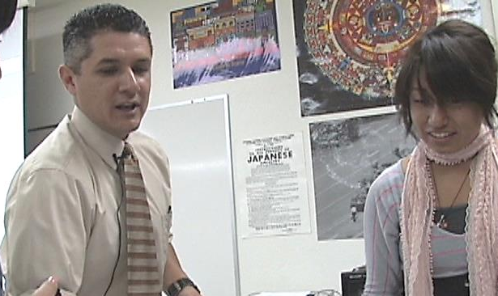
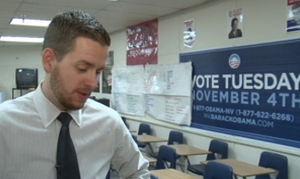
Teacher-to-Teacher Collaboration
T2T Collab
Middle & High School Social Studies & ELA Teachers
Interactive academic discussion strategies.

Slide 8
Florida CPALMS
SS.8.A.1.1
Provide supporting details for an answer from text, interview for oral history, check validity of information from research/text, and identify strong vs. weak arguments.
SS.912.S.7.4
Discuss the implications of social problems for society.
LAFS.K12.R.1.1
Read closely to determine what the text says explicitly and to make logical inferences from it; cite specific textual evidence when writing or speaking to support conclusions drawn from the text.
SS.912.S.8.9
Identify a community social problem and discuss appropriate actions to address the problem.
SP.PK12.US.4.4
Demonstrate understanding of information presented orally by using listening skills, including paying attention to cues, linking to prior knowledge, and considering speaker’s perspective and nonverbal messages.
SS.4.C.2.1
Discuss public issues in Florida that impact the daily lives of its citizens.

Slide 9
North Carolina
The Governor's School Social Science curriculum combines several key themes that are reflected in our courses. First, we want students to see themselves simultaneously as individuals and as participants in society. Secondly, while our material is firmly rooted in history, we use history to ground discussions of contemporary social problems. Finally, we want students to combine both classroom discussion and personal experience in meaningful, analytical ways. Social science must, after all, be "social" as well as "scientific."
Literate students comprehend as well as critique. Students are engaged and open-minded—but discerning—readers and listeners. They work diligently to understand precisely what an author or speaker is saying, but they also question an author’s or speaker’s assumptions and premises and assess the veracity of claims and the soundness of reasoning.
8.H.1.4 Use historical inquiry to evaluate the validity of sources used to construct historical narratives (e.g. formulates historical questions, gather data from a variety of sources, evaluate and interpret data and support interpretations with historical evidence).
All curriculum areas provide students with opportunities to interact with relevant and engaging text, including opportunities for reading, writing, speaking, listening and language use.

Slide 10
California
CCSS.ELA-LITERACY.SL.9-10.1 Initiate and participate effectively in a range of collaborative discussions (one-on-one, in groups, and teacher-led) with diverse partners on grades 9-10 topics, texts, and issues, building on others' ideas and expressing their own clearly and persuasively.
CCSS.ELA-LITERACY.SL.9-10.1.A Come to discussions prepared, having read and researched material under study; explicitly draw on that preparation by referring to evidence from texts and other research on the topic or issue to stimulate a thoughtful, well-reasoned exchange of ideas.
CCSS.ELA-LITERACY.SL.9-10.4 Present information, findings, and supporting evidence clearly, concisely, and logically such that listeners can follow the line of reasoning and the organization, development, substance, and style are appropriate to purpose, audience, and task.
CCSS.ELA-LITERACY.SL.9-10.1.D Respond thoughtfully to diverse perspectives, summarize points of agreement and disagreement, and, when warranted, qualify or justify their own views and understanding and make new connections in light of the evidence and reasoning presented.
CCSS.ELA-LITERACY.RH.6-8.1 Cite specific textual evidence to support analysis of primary and secondary sources.
CCSS.ELA-LITERACY.SL.11-12.1.B Work with peers to promote civil, democratic discussions and decision-making, set clear goals and deadlines, and establish individual roles as needed.

Slide 11
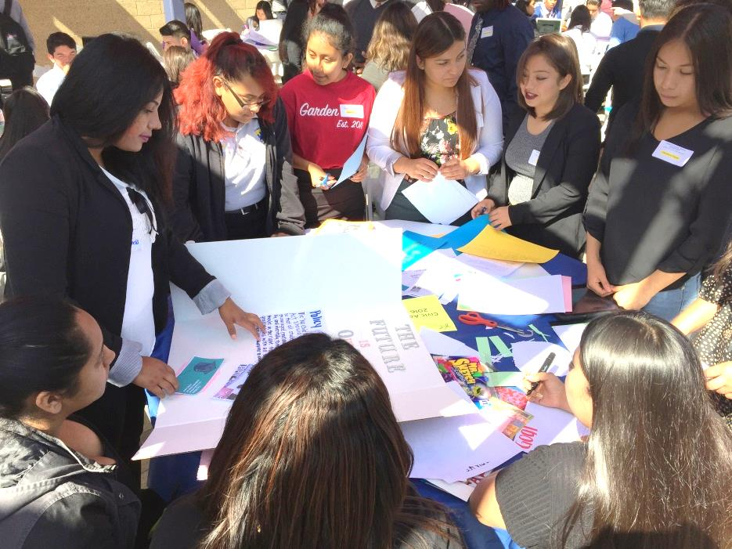
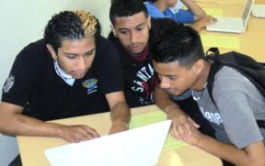
Evidence-based arguments.
Engaged, focused.
Diving in to sources.
Discussions using complex text.

Slide 12
What we have discovered:
Every student needs to participate.
Old cooperative learning model vs academic model.
Structured.
Text/content based leads to “evidence based”
(not “how do you feel about…”).
Discussion “guide” for students.
Assessment.

Slide 13
Civil Conversation
Ingredients of Civil Conversation
Text-based: An article that presents at least two perspectives, or more than one text that presents different views on the same issue/topic.
Presents a question for students to explore.
Pairs/small group.
Structured with a discussion guide.

Slide 14
Two “learning cycles” this semester:
1. Civil Conversation model.
2. Using simulation/role play lessons as academic discussion.

Slide 15
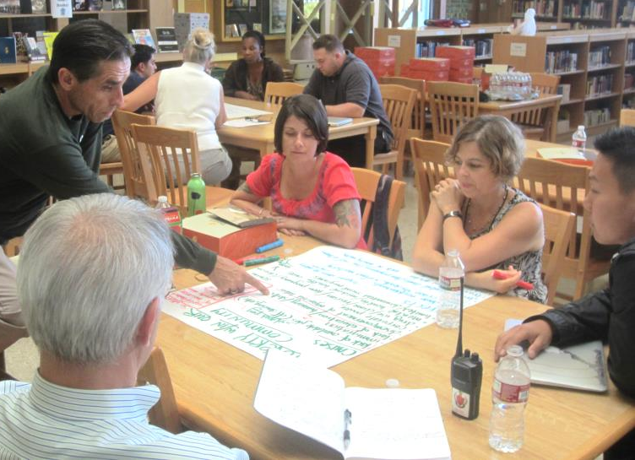
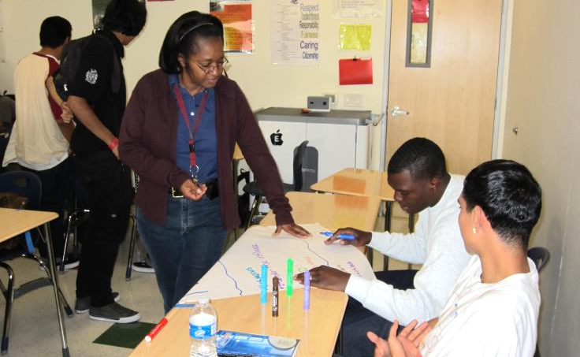
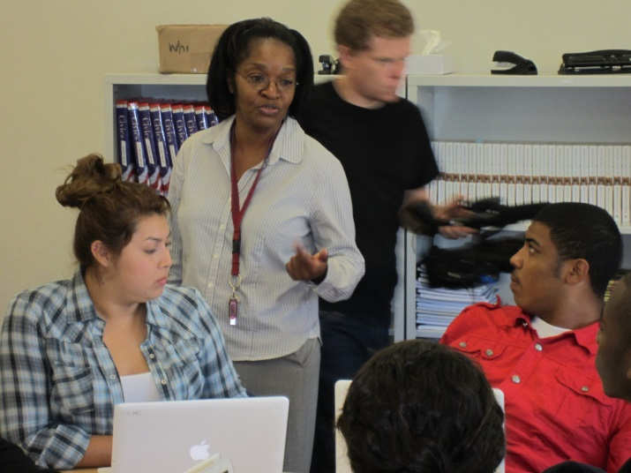
1. Face-to-face: CC Instructional Strategy
2. Try it out with your students.
3. Collaborate/Analyze/Reflect
Teach. Reflect. Reteach
4. Teach it again!

Slide 16
Timeline
Cohort Activities
JAN | FEB | MAR | APR | MAY | JUNE
Attend Webinar and F2F | Participate online discussion Teach a lesson using strategy | Reflect Attend Webinar Reteach | Attend F2F Teach a lesson using strategy | Reflect Attend Webinar Reteach | Online Discussion Eval Activities

Slide 17
Impact on Cohort Teachers
Is this project helping me implement standards? How so?
What is the benefit of engaging in PD lead by Teacher Leaders?
Evaluation Activities
“Flash Survey” – May or June
Before/After reflection rubric
Examples of how strategies were used in the classroom
A select few Los Angeles teachers will participate in one more evaluation activity. We will let you know if you are one of the “lucky” ones!

Slide 18
Additional PD Opportunities:
Webinars
Civil Conversation
Why discussion?
Using simulation/role play as discussion
Library of Congress lessons
…and?
Twitter Chats
Share Facebook posts
T2T website (free lessons,
archived webinars, etc.)

Slide 19
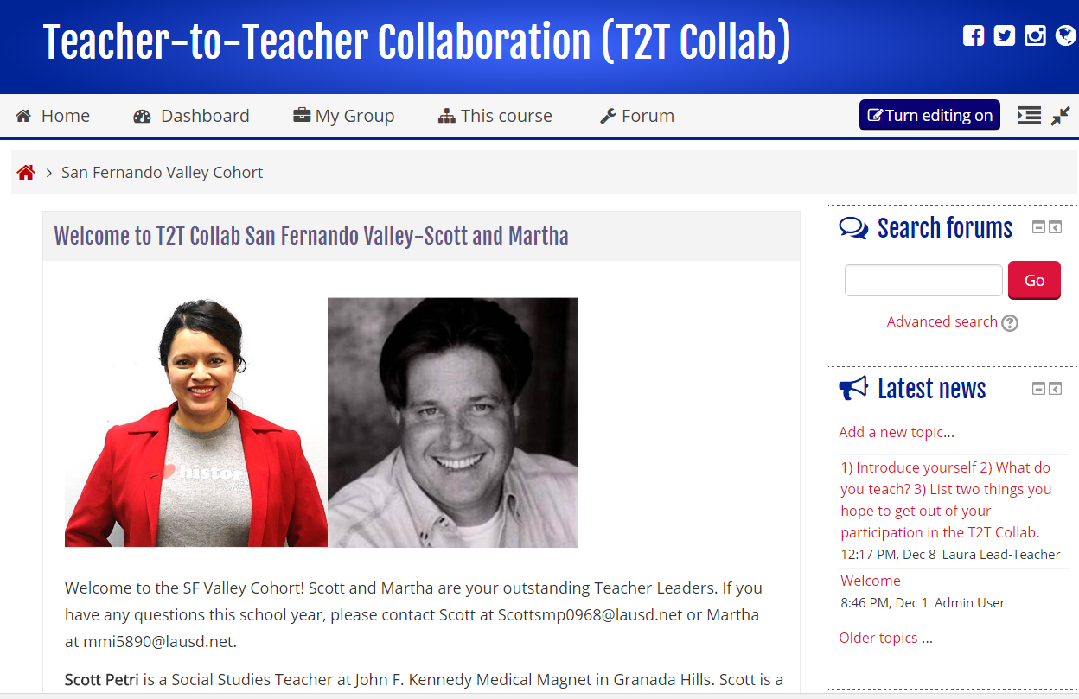
How you will collaborate with your Cohort? The Teacher Cohort website…

Slide 20
Next Steps
Support
Stipends
What else?

Slide 21
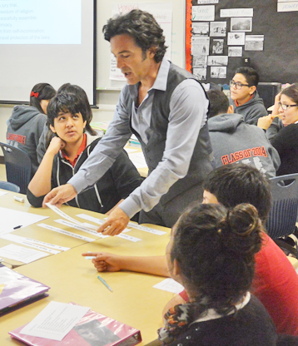
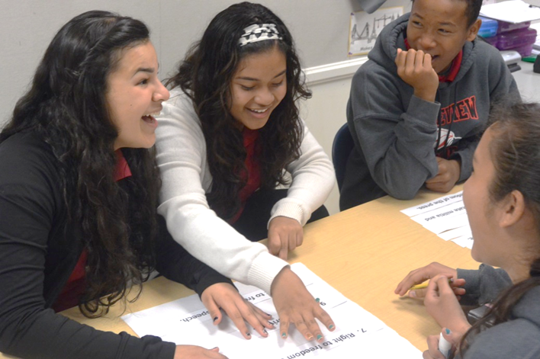
Precise, intentional, joyful teaching = purposeful, joyful learning.

