Slide 1

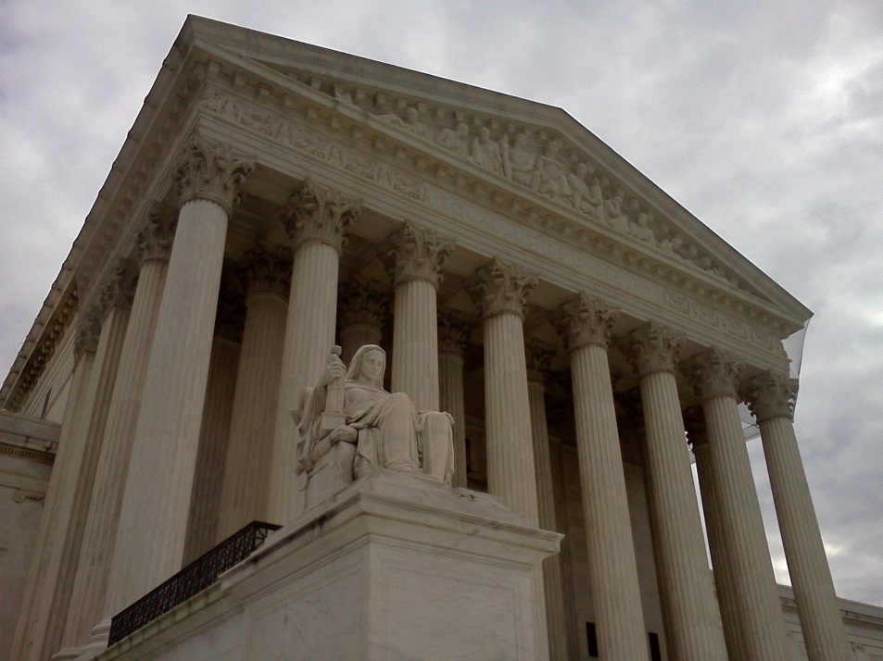

Supreme Court Trivia Question:
Which person was appointed to the Supreme Court after serving as U.S. president?
Using Supreme Court Cases to Teach Common Core Standards
Presenter: Damon Huss
Guest: Dean Erwin Chemerinsky

Slide 2
Poll Question #1
What is the main challenge you face in using Supreme Court cases in your classroom instruction?
a. Students have difficulty with “legalese.”
b. It takes too much class time.
c. I have never used Supreme Court cases in teaching before.
d. I use Supreme Court Cases in my teaching without much challenge.

Slide 3

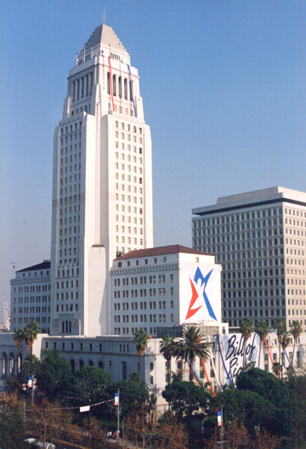
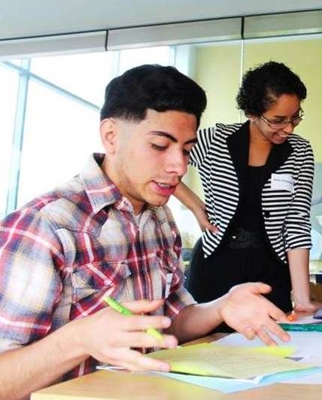
Constitutional Rights Foundation
CRF is a nonprofit, non-partisan, national educational organization. For over 50 years we’ve provided programs, training, and materials supporting teachers and students in the fields of civic and law-related education.
Check us out on the web! www.crf-usa.org

Slide 4
Objectives
Participants will be able to...
Gain background knowledge on the upcoming Supreme Court year and, specifically, on the law and affirmative action.
Use Common Core-aligned approaches to teaching about key Supreme Court decisions.
Implement a lesson to help students understand the process of Supreme Court decision-making using Fisher v. University of Texas as a model.

Slide 5
Take Our Survey!
If you are a K-12 teacher, take the survey after this webinar
to be eligible for a stipend of $50 for the first 10 teachers who register and attend the webinar, and
to be entered into a drawing for one of two $500 cash prizes or one of ten (10) $100 prizes.
This webinar and all of the above prizes and stipends are made available through a generous grant from the Bill and Melinda Gates Foundation.

Slide 6
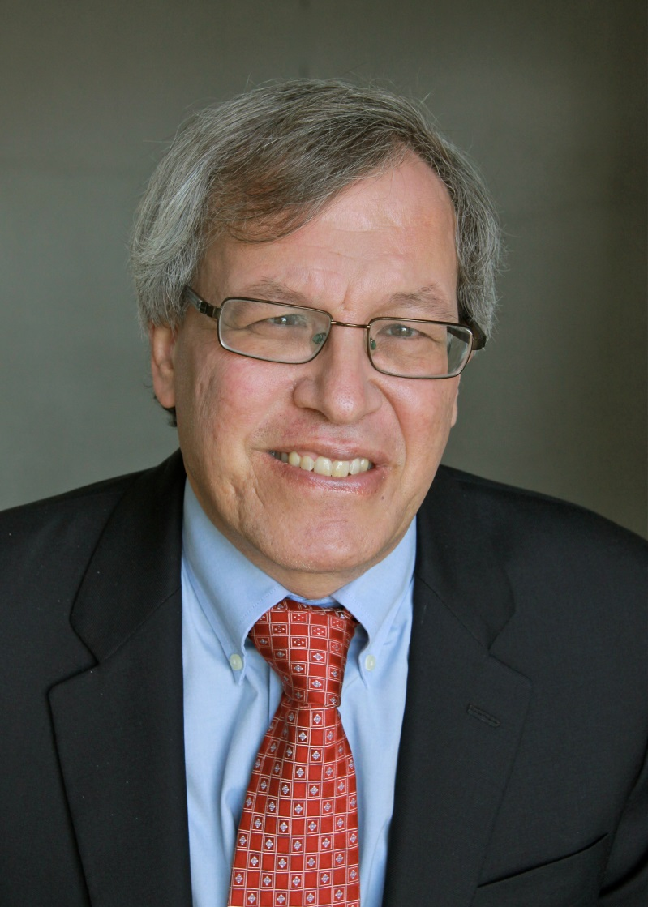
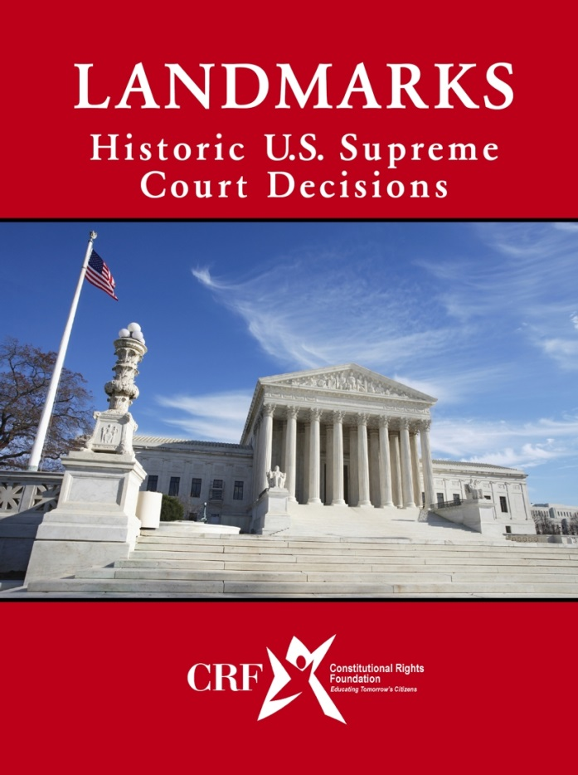
Erwin Chemerinsky
Career Highlights
2008 – present
Dean and Distinguished Professor of Law, University of California, Irvine School of Law
2004 – 2008
Professor of Law and Political Science, Duke University
1983 – 2004
Professor of Public Interest Law, Legal Ethics, and Political Science, Univ. of Southern California Law School
Selected Publications
The Case Against the Supreme Court (2014)
Constitutional Law (2013)
Criminal Procedure (2013)(with Laurie Levenson)
Interpreting the Constitution (1987)
“Affirmative action,” in Encyclopedia of Race and Racism (2007)
Equal Protection Clause
(Fourteenth Amendment)
“No State shall make or enforce any law which shall abridge the privileges or immunities of citizens of the United States; nor shall any State deprive any person of life, liberty, or property, without due process of law; nor deny to any person within its jurisdiction the equal protection of the laws.”
Cases Argued Before the Supreme Court
United States v. Apel (2013)(protests at military installations)
Van Orden v. Perry (2005)(establishment clause)
Tory v. Cochran (2005)(defamation)
Lockyer v. Andrade (2003)(Eighth Amendment)
Upcoming Affirmative Action Case
October Term 2015
FISHER V. UNIVERSITY OF TEXAS AT AUSTIN
Docket No. 14-981

Slide 7
Poll Question #2
What is the main method you use to discuss controversial topics in your classroom?
a. debate
b. whole-class discussion or deliberation
c. small-group discussion or deliberation
d. simulation and role play activities
e. I avoid discussion of controversies. It's too disruptive.

Slide 8
Poll Results for U.S. Adults 2013
Which comes closer to your view about evaluating students for admission into a college or university?
Solely on the basis of merit: 67%.
Racial and ethnic background should be considered: 28%.
Which comes closer to your view about evaluating students for admission into a college or university?
Applicants should be admitted solely on the basis of merit, even if that results in fewer minority students being admitted.
Applicants’ racial and ethnic background should be considered to help promote diversity on college campuses, even if that means admitting some minority students who otherwise should not be admitted.
Source: Gallup, July 24, 2013.

Slide 9
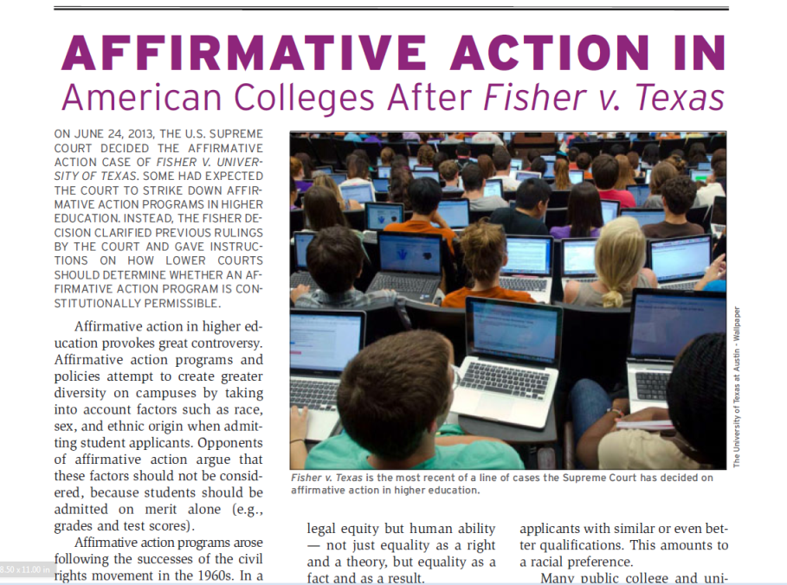
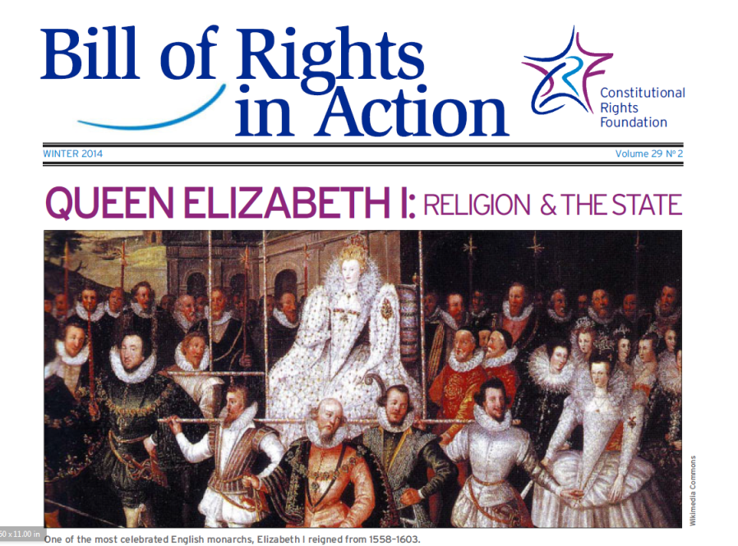
Teaching Affirmative Action Using the Fisher Case

Slide 10
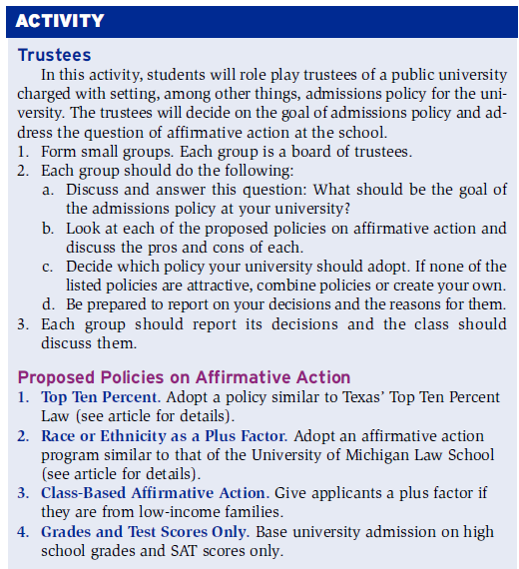
Role Play
Instructions for students (and teacher).
Information for student role-play discussion groups.

Slide 11
What are advantages of using role play?
Write your comments in the chat section.

Slide 12
Writing Activity #1
The Purpose of Affirmative Action
What is affirmative action? What is the purpose of
affirmative action programs at public universities? Do you think this is a valuable purpose? Explain your answers in at least one well-developed paragraph using evidence from the text of the article from Bill of Rights in Action.

Slide 13
Writing Activity #2
You Be the Judge
Imagine you are a Supreme Court justice. What did the Supreme Court decide in Fisher v. Texas? What would you have ruled if you were a justice on the court? Write one to two paragraphs using evidence from the article in Bill of Rights in Action to support your answer:
(a) If you agree with the Court’s decision, write a concurring opinion, stating your reasons for agreeing with the majority’s decision.
(b) If you disagree with the Court’s decision, write a dissenting opinion, stating your reasons for disagreeing with the majority’s decision.
Notes:
You Be the Judge: Note on Concurring Opinions
Usually, a concurring opinion, or concurrence, is one in which a justice agrees with the decision of the court but maybe for slightly different reasons.
In this activity, students may agree with the majority for the reasons stated by the majority, and they may want to simply emphasize some points of agreement over others. You may encourage your students to think of different reasons why they might have reached the same decision as the majority of justices. Students are free to use the text to help them think of more than one reason for their opinion.
You Be the Judge: Note on Dissenting Opinions
A dissenting opinion, or dissent, is one in which a justice disagrees with the majority of other justices in a particular case. Being a dissenter places you in the minority on the court. For example, in Fisher, seven justices were in the majority, and only Justice Ginsburg dissented. (Justice Kagan did not participate in the decision.)

Slide 14
Writing Activity #3
Are There Alternatives?
What alternatives to affirmative action do schools have to achieve greater diversity on their campuses?
Use the text of the article from Bill of Rights in Action to find evidence for your answer.
In addition, research what colleges and universities other than the University of Texas use to achieve greater diversity on campus.
In three paragraphs, explain the pros and cons of these alternatives. In the third paragraph, write a conclusion explaining whether you think these alternatives are more or less effective than affirmative action in achieving diversity. Explain your conclusion with evidence from your reading and research.
Notes:
This is an argumentative writing assignment focused on discipline-specific content.

Slide 15
Common Core State Standards
English-Language Arts
ELA-Literacy.RI.11-12.8
Delineate and evaluate the reasoning in seminal U.S. texts, including the application of constitutional principles and use of legal reasoning (e.g., in U.S. Supreme Court majority opinions and dissents) and the premises, purposes, and arguments in works of public advocacy (e.g., The Federalist, presidential addresses).
Notes:
Provide handout with expanded CCSS’s

Slide 16
Common Core State Standards
English-Language Arts
SL.11–12.4
Present information, findings, and supporting evidence, conveying a clear and distinct perspective, such that listeners can follow the line of reasoning, alternative or opposing perspectives are addressed, and the organization, development, substance, and style are appropriate to purpose, audience, and a range of formal and informal tasks.
Notes:
Provide handout with expanded CCSS’s

Slide 17
Common Core State Standards
History/Social Studies
ELA-Literacy.RH.11-12.1
Cite specific textual evidence to support analysis of primary and secondary sources, connecting insights gained from specific details to an understanding of the text as a whole.
ELA-Literacy.RH.11-12.2
Determine the central ideas or information of a primary or secondary source; provide an accurate summary that makes clear the relationships among the key details and ideas.
ELA-Literacy.RH.11-12.3
Evaluate various explanations for actions or events and determine which explanation best accords with textual evidence, acknowledging where the text leaves matters uncertain.
Notes:
Provide handout with expanded CCSS’s

Slide 18
Common Core State Standards
History/Social Studies
Text Types and Purposes:
ELA-Literacy.WHST.11-12.1
Write arguments focused on discipline-specific content.
Research to Build and Present Knowledge:
ELA-Literacy.WHST.11-12.9
Draw evidence from informational texts to support analysis, reflection, and research.
Range of Writing:
ELA-Literacy.WHST.11-12.10
Write routinely over extended time frames (time for reflection and revision) and shorter time frames (a single sitting or a day or two) for a range of discipline-specific tasks, purposes, and audiences.

Slide 19

UPCOMING FREE WEBINARS
Register:
http://www.crf-usa.org/pd
If Men Were Angels: Teaching the Constitution with the Federalist Papers.
October 8th, 2015 from 3:30 to 4:30 (PT)
The Common Core Does Not Have to Be a Great Wall: Fun Ways to Teach About China.
October 15, 2015 from 3:30 to 4:30 (PT)
Civic Engagement + Writing = Uncommonly Good Idea!
October 20, 2015 from 3:30 – 4:30 (PT)

Slide 20
Take Our Survey!
If you are a K-12 teacher, take the survey after this webinar
to be eligible for a stipend of $50 for the first 10 teachers who register and attend the webinar, and
to be entered into a drawing for one of two $500 cash prizes or one of ten (10) $100 prizes.
This webinar and all of the above prizes and stipends are made available through a generous grant from the Bill and Melinda Gates Foundation.

Slide 21
THANK YOU!
For support and information visit:
www.crf-usa.org
Link to the Gates survey:
http://crf-usa.org/common-core/survey
Special thanks to Laura Wesley at CRF for being the tech-savvy party to this webinar!

